Slide 1
Intro To Deep Learning
Alex Dimakis @AlexGDimakis
Nikolaos Vasiloglou @vasiloglou

Slide 2
Outline
Different types of neural networks
Multilayer perceptrons
Convolutional Neural Networks
Discriminator Networks (e.g. Inception V3)
Generators (GANs and VAEs)
Why depth
Why depth+Nonlinearity
Training by SGD vs GD

Slide 3
Types of ML problems
Supervised learning
Unsupervised
Active Learning/ Reinforcement Learning / Semi-supervised /other variations

Slide 4
Types of ML problems
Supervised learning
-Regression
-Classification
Unsupervised
Active Learning/ Reinforcement Learning / Semi-supervised /other variations

Slide 5
Types of ML problems
Supervised learning
-Regression
-Classification
Unsupervised
-Clustering, Data generation, data interpolation,...
Active Learning/ Reinforcement Learning / Semi-supervised /other variations

Slide 6
Types of Neural nets
Discriminators: Feed-forward neural nets for multi-label classification tasks. (e.g. Inception V3).
Generator models: Can be trained without labels. Learn to dream up of data that looks realistic. (e.g. VAEs and GANs)
RNNs: Recurrent architectures used for time-series and other sequential data. Can be used for generation or discrimination.

Slide 7

Types of Neural nets: Discriminators

Slide 8
Types of Neural nets: Discriminators
Pr(cat) =0.7
Pr(banana) =0.01
Pr(grumpy) =0.2
...
Pr(dog) =0.02

Slide 9
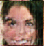
Types of Neural nets: Generators
random
noise
z
G(z)

Slide 10
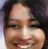
Types of Neural nets: Generators
random
noise
z
G(z)

Slide 11

Types of Neural nets: Generators
random
noise
z
G(z)

Slide 12

Types of Neural nets: Generators
random
noise
z
G(z)

Slide 13
Types of Neural nets: Generators
Any Resemblance
to Actual Persons,
Living or Dead,
is Purely Coincidental
random
noise
z
G(z)

Slide 14
MLP Architectures: warmup
A single linear neuron:
f(x) = w(1)*x(1) + w(2)*x(2)
x1 | x2 | Y
0 | 0 | 0
0 | 1 | 1
1 | 0 | 1
1 | 1 | 0
x(1)
w(1)
w(2)
y
x(2)

Slide 15
Depth 1 Model (warmup)
x1
x2
w₁
w₂
f(x)
Let’s start with a depth 1 model:
f(x) = w^{T} x +b , w in R², b in R.
The unknown parameters are θ={w1,w2,b}
Inference Exercise:
For weights θ={w1=1,w2=1,b=2}
Run this model and make a prediction when the input features are x= [x1= 2, x2= 3]
f(x) = ?
b

Slide 16
Depth 1 Model (warmup)
x1
x2
w₁
w₂
f(x)
Let’s start with a depth 1 model:
f(x) = w^{T} x +b , w in R², b in R.
The unknown parameters are θ={w1,w2,b}
Inference Exercise:
For weights θ={w1=1,w2=1,b=2}
Run this model and make a prediction when the input features are x= [x1= 2, x2= 3]
f(x) = w₁* x1 + w₂*x2 +b = 1*2 + 1*3 + 2 = 7
Notice that for general weights the output is
f(x) = w₁* 2 + w₂*3 +b
If the true value is f*(x) = 1 , the squared loss is function of the weights.
b

Slide 17
Model with 1 hidden layer
c₁
x₁
x₂
W₁₁
h₁
h₂
h= W^{T}x + c
f(x)= w^{T}h +b
w₁
W₁₂
f(x)
W₂₁
w₂
W₂₂
c₂

Slide 18
Model with 1 hidden layer
c₁
x₁
x₂
W₁₁
h₁
h₂
h= W^{T}x + c
f(x)= w^{T}h +b
w₁
W₁₂
f(x)
W₂₁
w₂
W₂₂
c₂
x
h
W,
c
w, b
f(x)

Slide 19
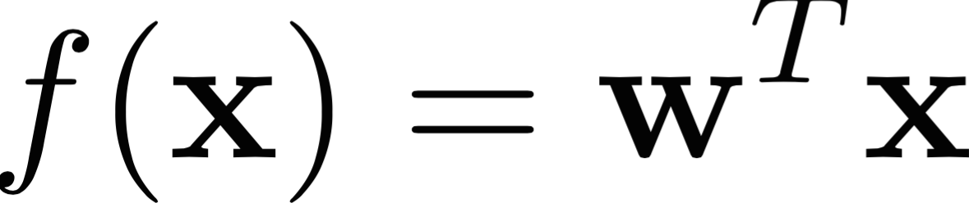
MLP Architectures: warmup
f(x) = w(1)*x(1) + w(2)*x(2)
x1 | x2 | Y
0 | 0 | 0
0 | 1 | 1
1 | 0 | 1
1 | 1 | 0
x(1)
w(1)
w(2)
y
x(2)
x= [x(1) x(2)]^{T} w=[ w(1) w(2) ]^{T}

Slide 20
MLP Architectures: warmup
A single nonlinear neuron:
f(x) = g( w(1)*x(1) + w(2)*x(2) )
x1 | x2 | Y
0 | 0 | 0
0 | 1 | 1
1 | 0 | 1
1 | 1 | 0
x(1)
w(1)
w(2)
g()
y
x(2)

Slide 21
MLP Architectures: warmup
A single nonlinear neuron:
f(x) = g( w(1)*x(1) + w(2)*x(2) )
x1 | x2 | Y
0 | 0 | 0
0 | 1 | 1
1 | 0 | 1
1 | 1 | 0
x(1)
w(1)
w(2)
g()
y
x(2)
(This is also known as logistic regression for
g(z)= 1/(1+exp(-z) )

Slide 22
MLP Architectures
x(1)
w₁(1)
h₀(1)
x(2)
w₁(2)
y
h₀(2)
w₁(3)
x(3)
w₁(4)
h₀(3)
x(4)

Slide 23
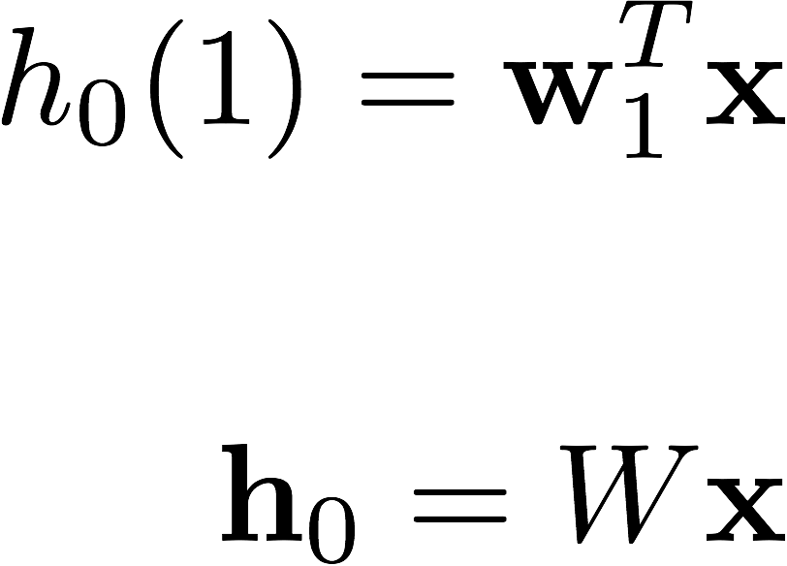
MLP Architectures
x(1)
w₁(1)
h₀(1)
x(2)
w₁(2)
y
h₀(2)
w₁(3)
x(3)
w₁(4)
h₀(3)
x(4)

Slide 24
MLP Architectures: Add activation functions
x(1)
g(z) = max (0, z)
(Rectifier Linear Unit ReLu)
w₁(1)
g(z)
h₀(1)
x(2)
w₁(2)
y
h₀(2)
w₁(3)
x(3)
w₁(4)
h₀(3)
x(4)

Slide 25
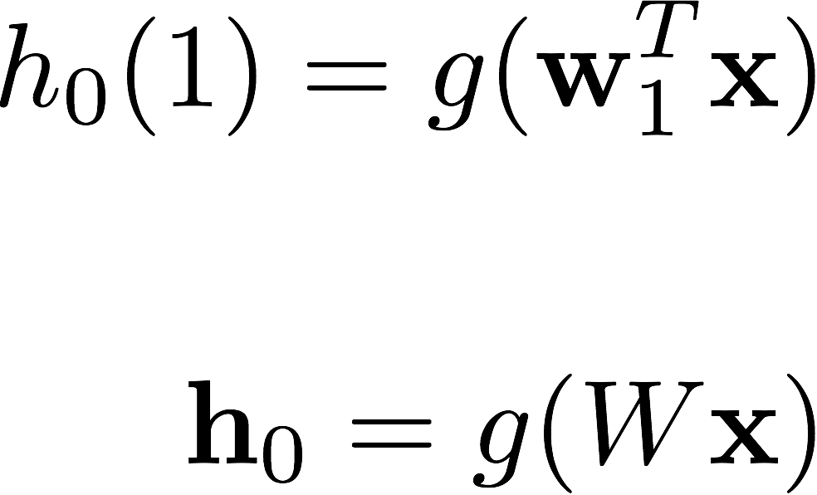
MLP Architectures: Add activation functions
x(1)
g(z) = max (0, z)
(Rectifier Linear Unit ReLu)
w₁(1)
g(z)
h₀(1)
x(2)
w₁(2)
y
h₀(2)
w₁(3)
x(3)
w₁(4)
h₀(3)
x(4)

Slide 26
Convolutional Neural Networks
How to re-use weights to get more efficient models.

Slide 27
CNNs: Idea of Convolutional filters
x(1)
w₁
h₀(1)
w₂
x(2)
y
h₀(2)
x(3)
h₀(3)
x(4)

Slide 28
CNNs: Idea of Convolutional filters
x(1)
w₁
h₀(1)
w₂
x(2)
y
w₁
h₀(2)
w₂
x(3)
w₁
h₀(3)
w₂
x(4)

Slide 29
CNNs: Idea of Convolutional filters
x(1)
w₁
Reuse weights
Avoid full connectivity
Reduce the number of parameters you have to train
Provide translational invariance.
Makes sense for images
h₀(1)
w₂
x(2)
y
w₁
h₀(2)
w₂
x(3)
w₁
h₀(3)
w₂
x(4)

Slide 30
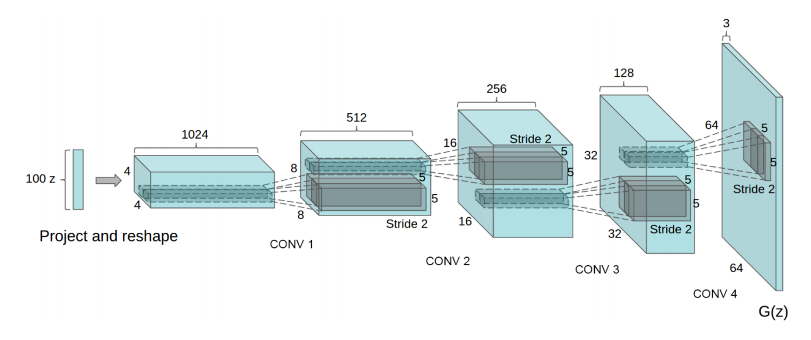
DCGan Architecture
based on https://github.com/carpedm20/DCGAN-tensorflow

Slide 31
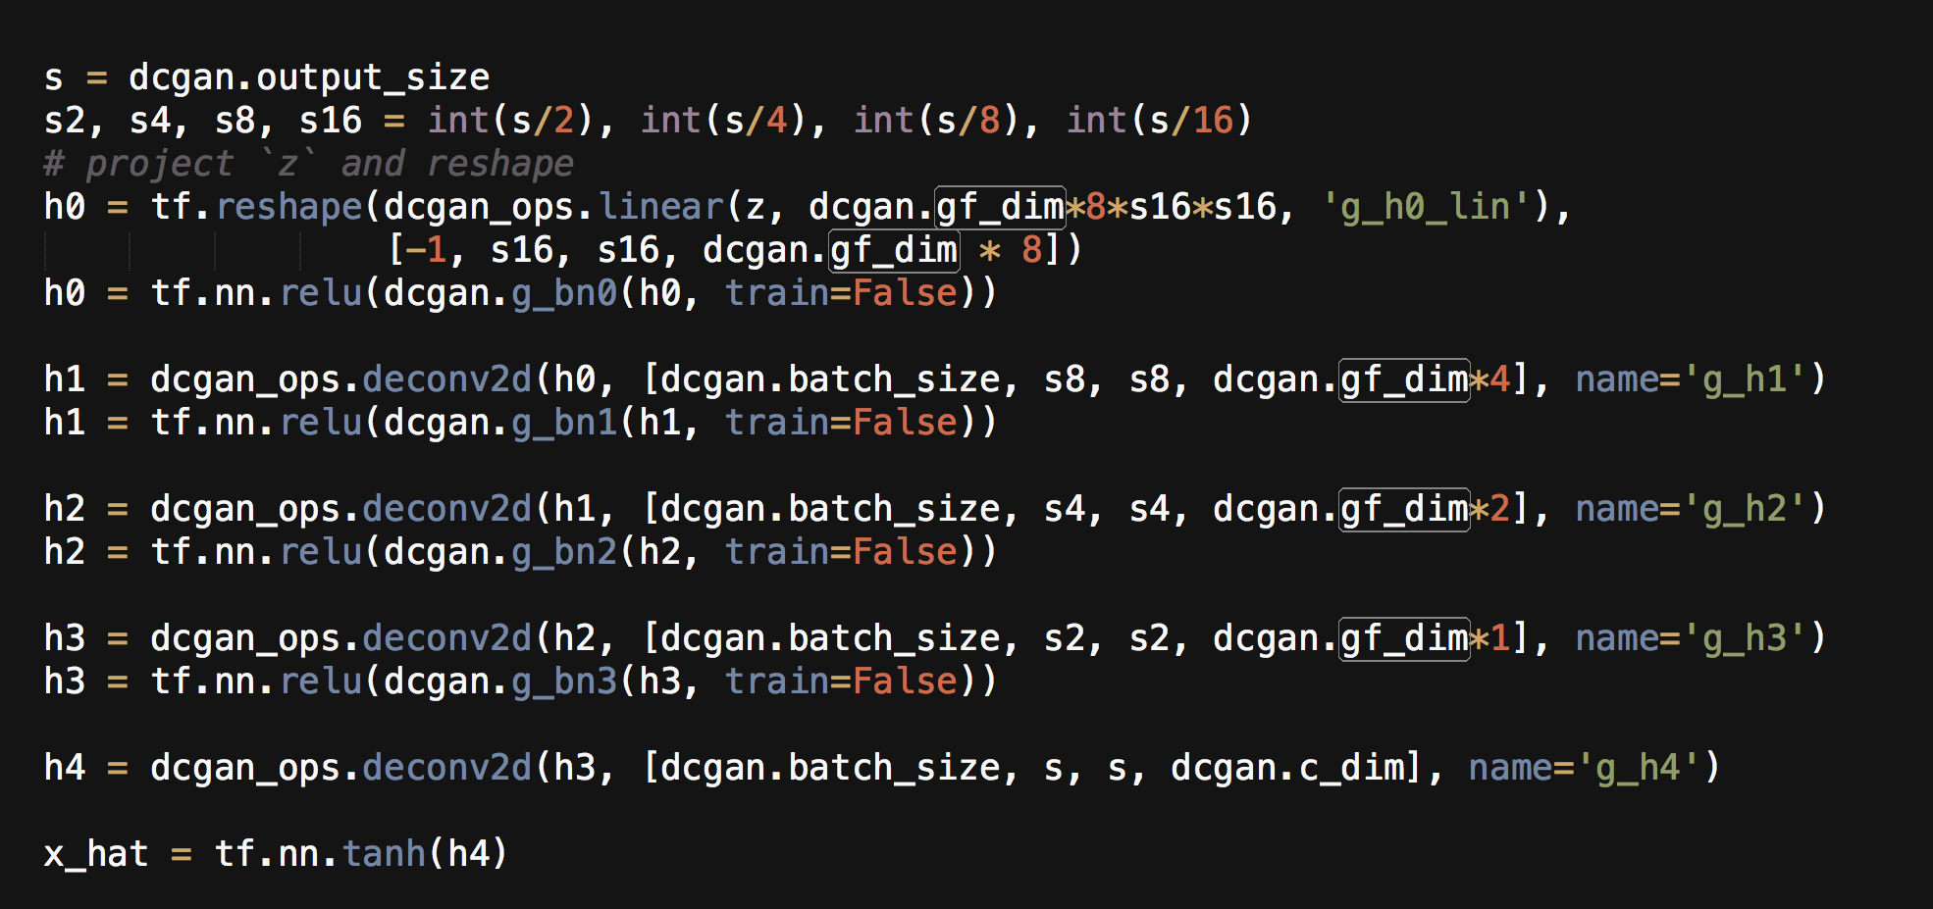
DCGan Architecture
based on https://github.com/carpedm20/DCGAN-tensorflow

Slide 32
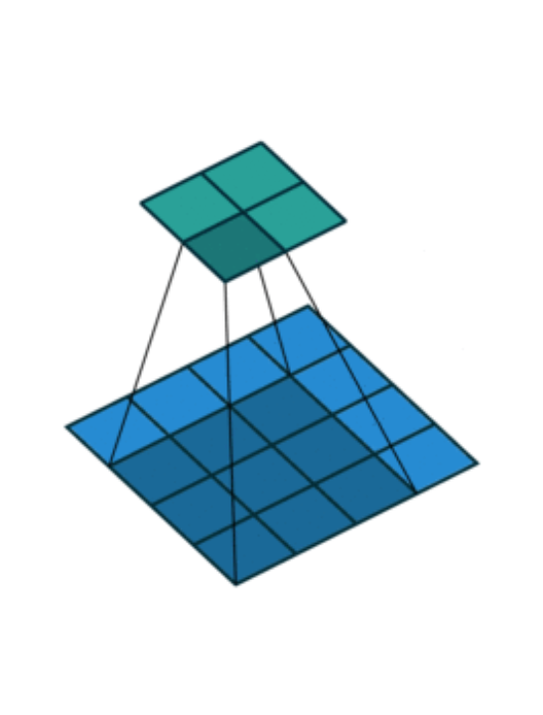
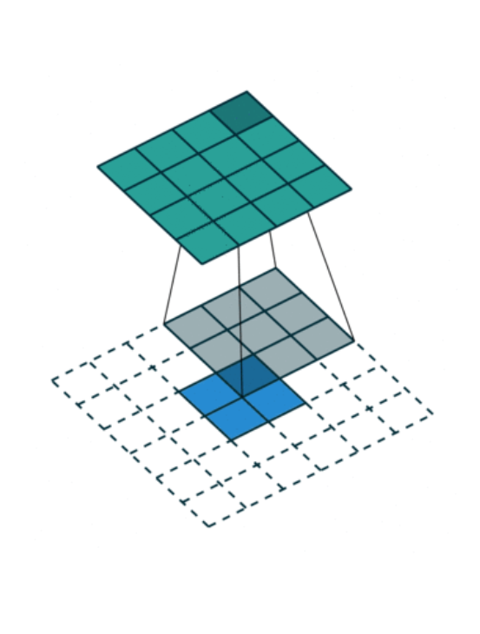
How deconvolution Layers work
Convolution Layer
DeConvolution Layer
(aka Transposed Convolution)
From: https://github.com/vdumoulin/conv_arithmetic
see for more fun animations

Slide 33
Why we need
hidden layers and nonlinearities?

Slide 34
Why hidden layers ?
In machine learning you are given a vector x of d features.
You often expand it into say d² features and get better performance.
This can be done in three ways:

Slide 35
Why hidden layers ?
In machine learning you are given a vector x of d features.
You often expand it into say d² features and get better performance.
This can be done in three ways:
Problem specific feature engineering

Slide 36
Why hidden layers ?
In machine learning you are given a vector x of d features.
You often expand it into say d² features and get better performance.
This can be done in three ways:
Problem specific feature engineering
Embed in very general space and use Kernels.

Slide 37
Why hidden layers ?
In machine learning you are given a vector x of d features.
You often expand it into say d² features and get better performance.
This can be done in three ways:
Problem specific feature engineering
Embed in very general space and use Kernels.
Learn the features from data.

Slide 38
Why hidden layers ?
In machine learning you are given a vector x of d features.
You often expand it into say d² features and get better performance.
This can be done in three ways:
Problem specific feature engineering
Embed in very general space and use Kernels.
Learn the features from data. You can do this if the model has end-to-end differentiation.

Slide 39
Why do we need Deep
and nonlinear networks?
Alex Dimakis @AlexGDimakis
Nikolaos Vasiloglou @vasiloglou

Slide 40
example: Learning using gradient
Let’s start with a depth 1 model:
f(x) = w^{T} x +b , w in R², b in R.
The unknown parameters are θ={w1,w2,b}
Learn from data.
What is d and n here?
What is a sensible loss function?
x1 | x2 | f*(x1,x2)= x1 XOR x2
0 | 0 | 0
0 | 1 | 1
1 | 0 | 1
1 | 1 | 0
w₁
x1
x2
w₂
f(x)
b
See example from Ch6 GoodFellow et al. Book

Slide 41
let’s work on an example
Let’s start with a depth 1 model:
f(x) = w^{T} x +b , w in R², b in R.
The unknown parameters are theta={w1,w2,b}
Loss= J(θ)= squared loss…
x1 | x2 | f*(x1,x2)= x1 XOR x2
0 | 0 | 0
0 | 1 | 1
1 | 0 | 1
1 | 1 | 0

Slide 42
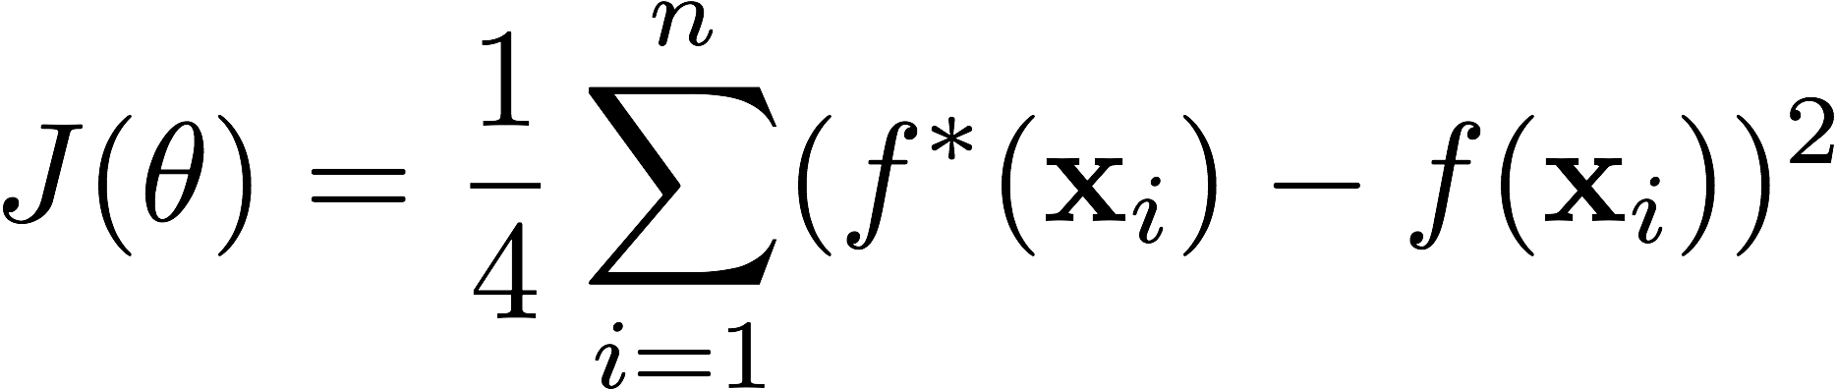
let’s work on an example
Let’s start with a depth 1 model:
f(x) = w^{T} x +b , w in R², b in R.
The unknown parameters are theta={w1,w2,b}
Loss= J(θ)
x1 | x2 | f*(x1,x2)= x1 XOR x2
0 | 0 | 0
0 | 1 | 1
1 | 0 | 1
1 | 1 | 0

Slide 43
let’s work on an example
x1
x2
w₁
w₂
f(x)
x1 | x2 | f*(x1,x2)= x1 XOR x2
0 | 0 | 0
0 | 1 | 1
1 | 0 | 1
1 | 1 | 0
b
f(x) = w^{T} x +b , w in R², b in R.
weights θ={w1,w2,b}
Loss= J(θ)
Exercise: Compute
1.predictions f(x) and
2. loss for J(θ)
For θ={w1=0,w2=1,b=1}

Slide 44
let’s work on an example
x1
x2
w₁
w₂
f(x)
x1 | x2 | f*(x1,x2)= x1 XOR x2
0 | 0 | 0
0 | 1 | 1
1 | 0 | 1
1 | 1 | 0
b
f(x) = w^{T} x +b , w in R², b in R.
weights θ={w1,w2,b}
Loss= J(θ)
Exercise: Compute
1.predictions f(x) and
2. loss for J(θ)
For θ={w1=0,w2=1,b=1}
f(x) = [ 1
2
1
2]
Loss J(θ) = ¼* ( (0-1)² + (1-2)²+ ( 1-1)²+(0-2)² )
= ¼ * ( 1+1+ 0+4) = 6/4

Slide 45
How to train
Let’s start with a depth 1 model:
f(x) = w^{T} x +b , w in R², b in R.
The unknown parameters are theta={w1,w2,b}
Loss= J(theta) = ¼ ( (0 - ( (0,0)*(w1,w2)+b) )²
Compute the gradient of the loss and move the model !
x1 | x2 | f*(x1,x2)=x1 XOR x2
0 | 0 | 0
0 | 1 | 1
1 | 0 | 1
1 | 1 | 0

Slide 46
How to train
Let’s start with a depth 1 model:
f(x) = w^{T} x +b , w in R², b in R.
The unknown parameters are theta={w1,w2,b}
Loss= J(theta) = ¼ ( (0 - ( (0,0)*(w1,w2)+b) )²
(1 - (0,1)*(w1,w2)+b) )²+
(1 - (1,0)*(w1,w2)+b) )²+
...
Compute the gradient of the loss and move the model !
x1 | x2 | f*(x1,x2)=x1 XOR x2
0 | 0 | 0
0 | 1 | 1
1 | 0 | 1
1 | 1 | 0

Slide 47
How to train
Let’s start with a depth 1 model:
f(x) = w^{T} x +b , w in R², b in R.
The unknown parameters are theta={w1,w2,b}
d=3, n=4.
Loss= J(theta) = ¼ ( (0 - ( (0,0)*(w1,w2)+b))²
(1 - (0,1)*(w1,w2)+b))²+
(1 - (1,0)*(w1,w2)+b))²+
(0 - (1,1)* (w1,w2)+b))².
Compute the gradient of the loss and move the model !
x1 | x2 | f*(x1,x2)=x1 XOR x2
0 | 0 | 0
0 | 1 | 1
1 | 0 | 1
1 | 1 | 0

Slide 48
How to train
Let’s start with a depth 1 model:
f(x) = w^{T} x +b , w in R², b in R.
The unknown parameters are theta={w1,w2,b}
d=3, n=4.
Loss= J(theta) = ¼ ( (0 - b)²
(1 - (0,1)*(w1,w2)+b)²+
(1 - (1,0)*(w1,w2)+b)²+
(0 - (1,1)* (w1,w2)+b)².
Compute the gradient of the loss and move the model !
x1 | x2 | f*(x1,x2)=x1 XOR x2
0 | 0 | 0
0 | 1 | 1
1 | 0 | 1
1 | 1 | 0

Slide 49
Computing gradient
Let’s start with a depth 1 model:
f(x) = w^{T} x +b , w in R², b in R.
The unknown parameters are theta={w1,w2,b}
d=3, n=4.
Loss= J(theta) = ¼ ( (0 - b)²
(1 -w₂-b)²+
(1 - w₁-b)²+
(0 -w₁-w₂-b)².
Compute the gradient of the loss and move the model !
x1 | x2 | f*(x1,x2)=x1 XOR x2
0 | 0 | 0
0 | 1 | 1
1 | 0 | 1
1 | 1 | 0

Slide 50
let’s work on an example
Let’s start with a depth 1 model:
f(x) = w^{T} x +b , w in R², b in R.
The unknown parameters are theta={w1,w2,b}
d=3, n=4.
Loss= J(theta) = ¼ ( (0 - b)²
(1 -w₂-b)²+
(1 - w₁-b)²+
(0 -w₁-w₂-b)².
The gradient is a vector.
first coordinate is …?
x1 | x2 | f*(x1,x2)=x1 XOR x2
0 | 0 | 0
0 | 1 | 1
1 | 0 | 1
1 | 1 | 0

Slide 51
let’s work on an example
Let’s start with a depth 1 model:
f(x) = w^{T} x +b , w in R², b in R.
The unknown parameters are theta={w1,w2,b}
d=3, n=4.
Loss= J(theta) = ¼ ( (0 - b)²
(1 -w₂- b)²+
(1 - w₁-b)²+
(0 -w₁-w₂-b)².
The gradient is a vector.
first coordinate is dJ / dw₁
Second is dJ / dw₂
Third is dJ / db
x1 | x2 | f*(x1,x2)=x1 XOR x2
0 | 0 | 0
0 | 1 | 1
1 | 0 | 1
1 | 1 | 0

Slide 52
let’s work on an example
Let’s start with a depth 1 model:
f(x) = w^{T} x +b , w in R², b in R.
The unknown parameters are theta={w1,w2,b}
d=3, n=4.
Loss= J(theta) = ¼ ( (0 - b)²
(1 -w₂- b)²+
(1 - w₁-b)²+
(0 -w₁-w₂-b)².
The gradient is a vector.
first coordinate is dJ / dw₁
Second is dJ / dw₂ = 2/4
Third is dJ / db
x1 | x2 | f*(x1,x2)=x1 XOR x2
0 | 0 | 0
0 | 1 | 1
1 | 0 | 1
1 | 1 | 0
2w₁+ w₂+2 b -1
w1+2w2+2b -1
2w1+2w2+4b-1

Slide 53
The problem with linear models.
f(x) = w^{T} x +b , w in R², b in R.
The unknown parameters are theta={w1,w2,b}
You can train this in TF or by hand and find the optimal w and b.
w*=[0,0] and b*=½
Run this model for some input, eg x=[1,0]?
x1 | x2 | f*(x1,x2)=x1 XOR x2
0 | 0 | 0
0 | 1 | 1
1 | 0 | 1
1 | 1 | 0

Slide 54
The problem with linear models.
f(x) = w^{T} x +b , w in R², b in R.
The unknown parameters are theta={w1,w2,b}
You can train this in TF or by hand and find the optimal w and b.
w*=[0,0] and b*=½
Run this model for some input, eg x=[1,0]?
We can prove that linear networks of
any depth will not learn the XOR.
But nonlinear networks with one hidden layer will.
x1 | x2 | f*(x1,x2)=x1 XOR x2
0 | 0 | 0
0 | 1 | 1
1 | 0 | 1
1 | 1 | 0

Slide 55
1 hidden layer- linear
h= W^{T}x + c
y= w^{T}h +b
Why can this not learn
the XOR ?
x1
x2
h1
h2
w,b
y
W,c
See example from Ch6 GoodFellow et al. Book

Slide 56
1 hidden layer- linear
h= W^{T}x + c
y= w^{T}h +b
So y = w^{T}(W^{T}x + c ) +b
y= w^{T}W^{T}x + w^{T}c + b
y= w’^{T}x + b’
x1
x2
h1
h2
w,b
y
W,c
See example from Ch6 GoodFellow et al. Book

Slide 57
1 hidden layer- linear
h= W^{T}x + c
y= w^{T}h +b
So y = w^{T}(W^{T}x + c ) +b
y= w^{T}W^{T}x + w^{T}c + b
y= w’^{T}x + b’
A deep linear model with any number of layers is just a linear model end-to-end.
So it will always produce the ½ constant prediction for any input x
x1
x2
h1
h2
w,b
y
W,c
See example from Ch6 GoodFellow et al. Book

Slide 58
1 hidden layer- ReLu
h= g( W^{T}x + c )
y= w^{T}h +b
Try W= [1,1; 1,1] c=[0,-1]^{T}
w=[1,-2]^{T} and b=0
h(0,0) =g([0,-1]^{T})= [0,0]^{T}
y= 0
x1
x2
h1
h2
w,b
y
W,c
g(z) = max ( z, 0)
Relu Link function
See example from Ch6 GoodFellow et al. Book

Slide 59
1 hidden layer- ReLu
h= g( W^{T}x + c )
y= w^{T}h +b
Try W= [1,1; 1,1] c=[0,-1]^{T}
w=[1,-2]^{T} and b=0
h(0,1) =g([1,0]^{T})= [1,0]^{T}
f(0,1)= 1
It has learned correctly all 4 inputs!
x1
x2
h1
h2
w,b
y
W,c
g(z) = max ( z, 0)
Relu Link function
See example from Ch6 GoodFellow et al. Book

Slide 60
Adversarial Examples
(not adversarial Training, yet)

Slide 61
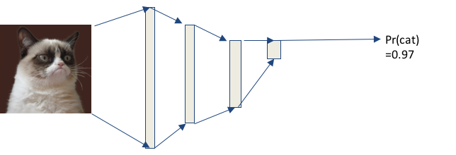
adversarial examples
Think of the discriminator as describing a distribution in 12000 dimensions

Slide 62
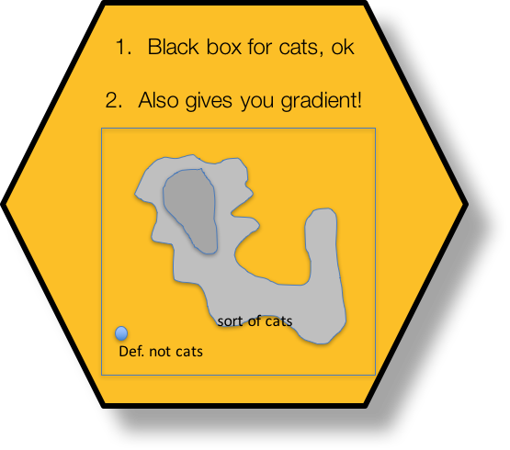

Slide 63
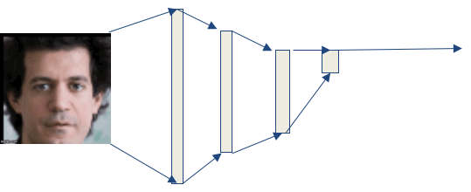
adversarial examples
P(cat) = 0.001

Slide 64
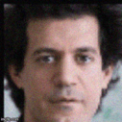
adversarial examples
P(cat) = 0.978 !

Slide 65
Word2Vec and Word embeddings
Alex Dimakis @AlexGDimakis
Nikolaos Vasiloglou @vasiloglou

Slide 66
Continuous Bag of Words (Mikolov et al. 2013)
`For a successful technology, reality must take precedence over public relations, since nature cannot be fooled..’
`.. since nature ***** be fooled..’
y1
y2
y3
…
y_{V}
y
x1
x2
..
x_{Y}
h1
h2
..
h_{N}
Context
W
W’
Current word
One hot-encoded of previous word

Slide 67
Continuous Bag of Words (Mikolov et al. 2013)
Each row of W is a vector representation of a word v_{p}^{T}
Score for next word = u_{j}^{T} h
Where u_{j} is the jth column
of W’
x1
x2
..
x_{Y}
y1
y2
y3
…
y_{V}
h1
h2
..
h_{N}
W
W’
One hot-encoded of previous word

Slide 68
Continuous Bag of Words (Mikolov et al. 2013)
Each row of W is a vector representation of a word v_{p}^{T}
Score for next word = u_{j}^{T} h
Where u_{j} is the jth column
of W’
Then us softmax to obtain the posterior distribution on words:
y1
y2
y3
…
y_{V}
y
x1
x2
..
x_{v}
p1
p2
p3
…
p_{V}
h1
h2
..
h_{N}
W
W’
One hot-encoded of previous word

Slide 69
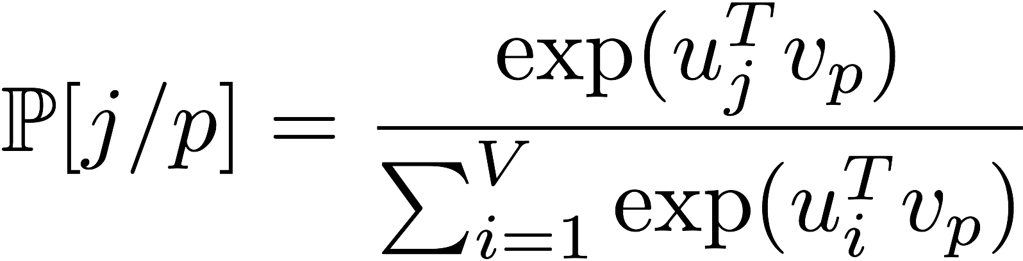
Continuous Bag of Words (Mikolov et al. 2013)
For each word we have v_{i} and u_{i}
y1
y2
y3
…
y_{V}
y
x1
x2
..
x_{v}
p1
p2
p3
…
p_{V}
h1
h2
..
h_{N}
W
W’
One hot-encoded of previous word

Slide 70
word2vec
For each word, its embedding captures the semantic geometry of the trained corpus.
u[ `Man’] is similar to u[‘suspect’]
(trained on news)

Slide 71
word2vec
Demo requires installing gensim and downloading GoogleNews-vectors-negative300.bin.gz pre-trained word2vec from https://code.google.com/p/word2vec/
w.most_similar('man')
[(u'woman', 0.7664012312889099), (u'boy', 0.6824870705604553), (u'teenager', 0.6586930751800537), (u'teenage_girl', 0.6147903203964233), (u'girl', 0.5921714305877686), (u'suspected_purse_snatcher', 0.571636438369751), (u'robber', 0.5585119724273682), (u'Robbery_suspect', 0.5584409832954407), (u'teen_ager', 0.5549197196960449), (u'men', 0.5489763021469116)]

Slide 72
Using Transfer Learning
and Interpretability
Alex Dimakis
Nikolaos Vasiloglou

Slide 73
Get Inception V3 (massive pre-trained MLP)
Pr(cat) =0.7
Pr(banana) =0.01
Pr(grumpy) =0.2
...
Pr(dog) =0.02

Slide 74
Get Inception V3 (massive pre-trained MLP)
Trained on ImageNet.
Can recognize 1000 Class labels.
Trained on Millions of images,
Often better than typical human performance
Pr(cat) =0.7
Pr(banana) =0.01
Pr(grumpy) =0.2
...
Pr(dog) =0.02

Slide 75
Transfer Learning: How to leverage this power
https://research.googleblog.com/2016/03/train-your-own-image-classifier-with.html
Pr(cat) =0.7
Pr(banana) =0.01
Pr(grumpy) =0.2
...
Pr(dog) =0.02

Slide 76
Transfer Learning: How to leverage this power
https://research.googleblog.com/2016/03/train-your-own-image-classifier-with.html
Pr(cat) =0.7
Pr(banana) =0.01
Pr(grumpy) =0.2
...
Pr(dog) =0.02

Slide 77
Transfer Learning: How to leverage this power
https://research.googleblog.com/2016/03/train-your-own-image-classifier-with.html
Excellent image features.
Train a logistic regression on your problem.
Or an XGBoost classifier or any other model inside or outside TF.

Slide 78
Interpretability and Trust
``Why Should I Trust You?” Explaining the Predictions of Any Classifier.’’. Ribeiro et al. KDD 2016.
``Streaming Weak Submodularity: Interpreting Neural Networks on the fly.’’. (my group- uploaded on drive)
Problem: Given a black box model: ask
WHY did it give this label for this input.

Slide 79
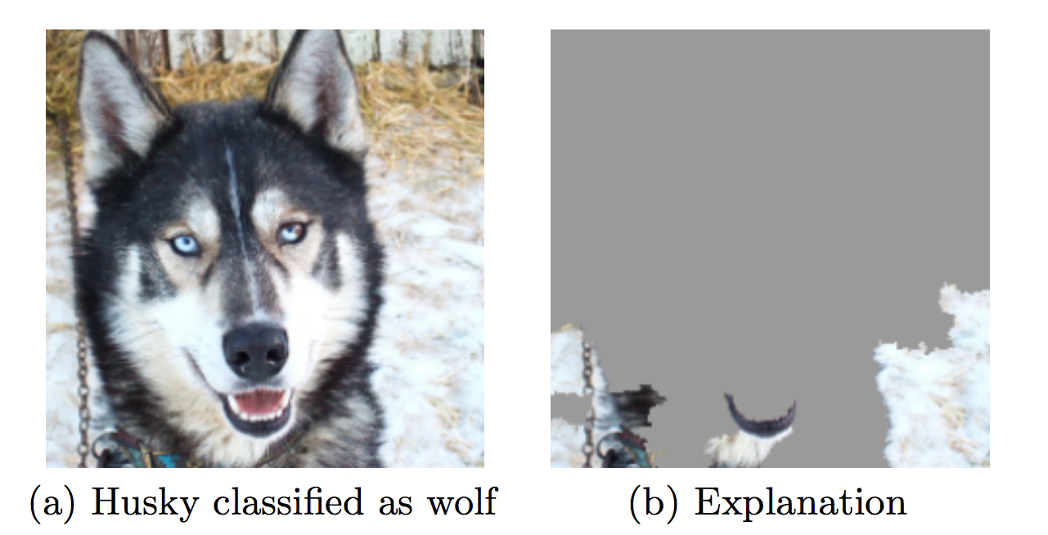
Interpretability and Trust
Interpretability is related to trust.

Slide 80
Interpretability and Trust
Interpretability is related to trust.
Malware detector had excellent accuracy over train-test split with true holdout.

Slide 81
Interpretability and Trust
Interpretability is related to trust.
Malware detector had excellent accuracy over train-test split with true holdout.
Was just checking if the code had comments.

Slide 82
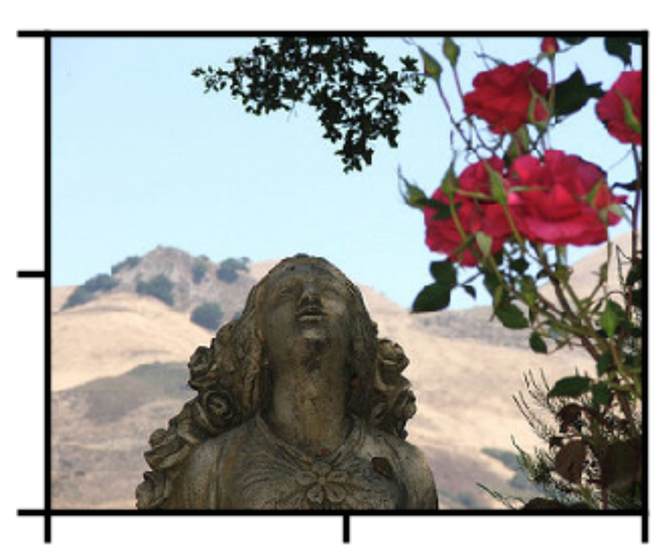
The idea:
R1
Segment image into regions
Feed subsets of the regions in the black box.
Black out the rest image.
Find which 3 regions maximize the likelihood of ‘Rose’
R2

Slide 83
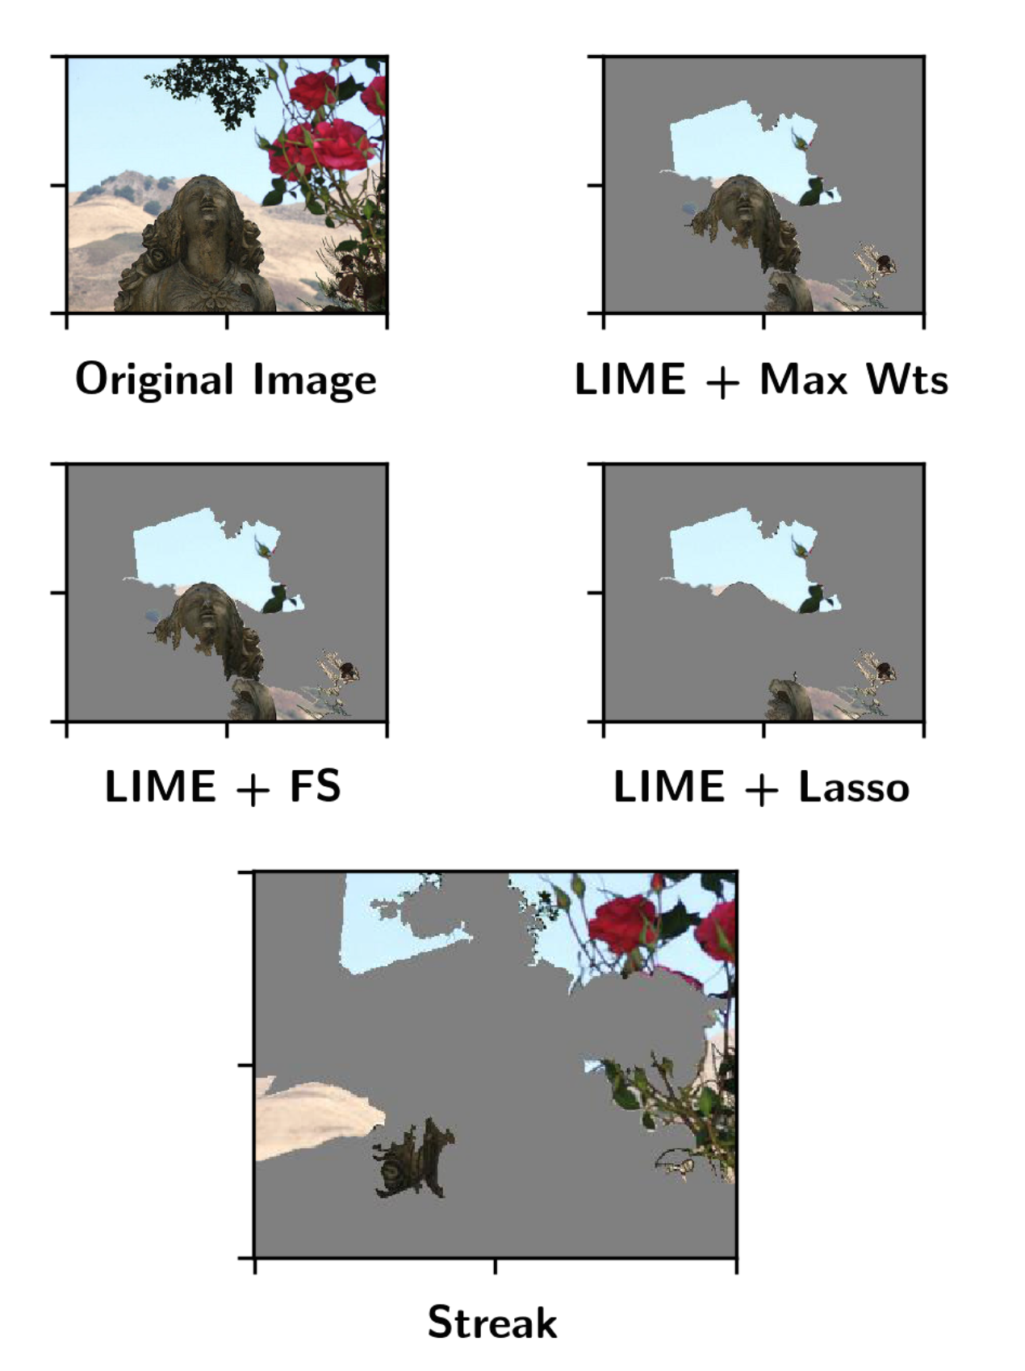
Lime and Streak

Slide 84
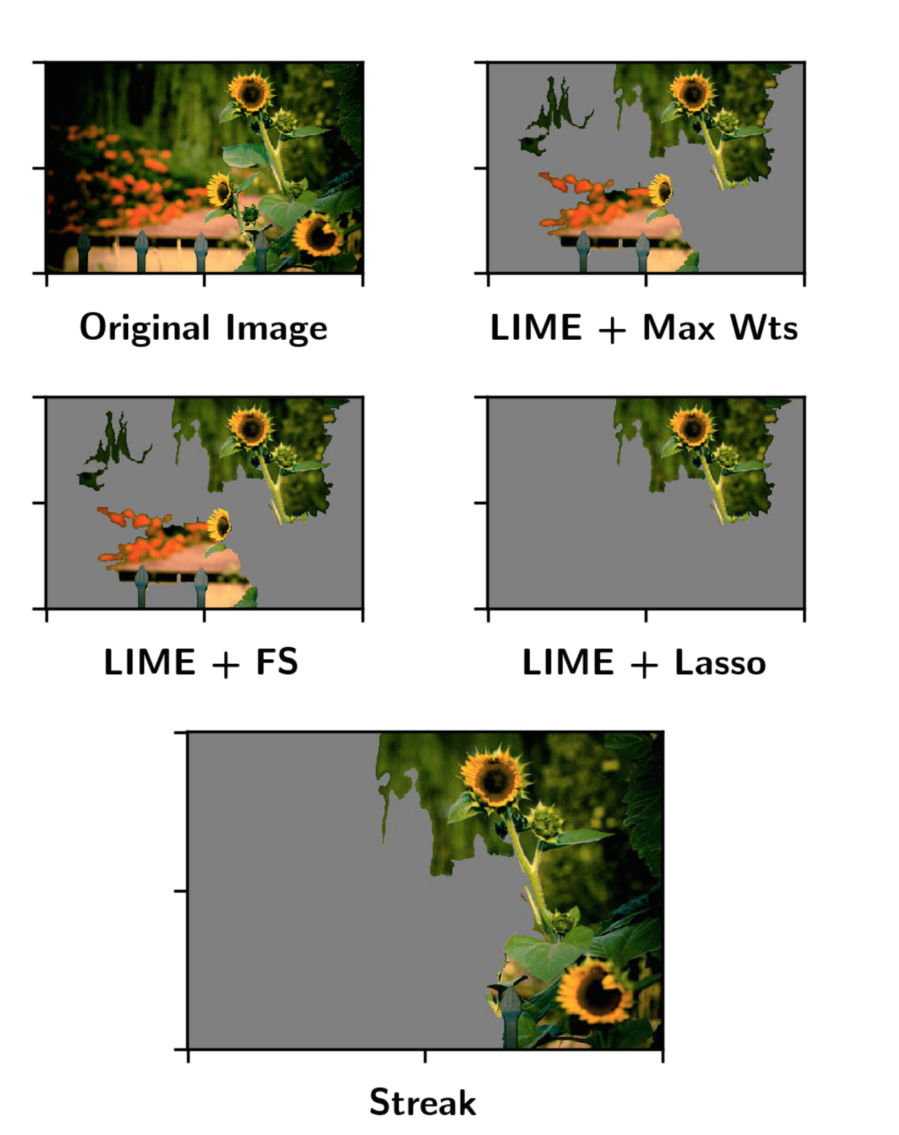
Lime and Streak

Slide 85
Interpretability and Trust
This is a very complex and hot topic in ML currently
Trusting for deployment
For scientific discovery

Slide 86
Interpretability and Trust
This is a very complex and hot topic in ML currently
Trusting for deployment
For scientific discovery
For Discrimination and Fairness

Slide 87
Interpretability and Trust
This is a very complex and hot topic in ML currently
Trusting for deployment
For scientific discovery
For Discrimination and Fairness
(e.g. Loan applications, Employment, News, ?)

Slide 88
Interpretability and Trust
This is a very complex and hot topic in ML currently
Trusting for deployment
For scientific discovery
For Discrimination and Fairness
(e.g. Loan applications, Employment, News, ?) Very interesting complex topic:
http://www.mlandthelaw.org/slides/hajian.pdf
http://www.mlandthelaw.org/ http://www.fatml.org/resources

